Slide 1
UNIT 2: NATURE’S BOUNTY
THE STORY OF AMBER BEADS
- JANE ANDREWS

Slide 2
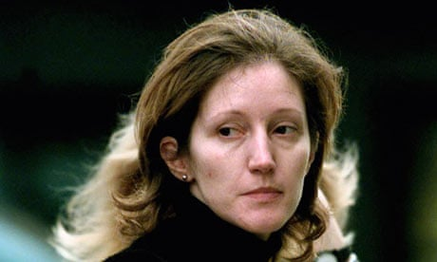
Jane Andrews (1833-1887) was an American author and educator. She is a writer of popular children's books. Her first book was Seven Little Sisters Who Live on the Round Ball That Floats in the Air (1861). a collection of stories about seven young girls who live in different, unusual places. This story is an extract from The Stories Mother Nature Told Her Children (1889).

Slide 3
Jane Dawn Elizabeth Andrews (born 1 April 1967) is an English former royal dresser for Sarah, Duchess of York, who was imprisoned in 2001 for murdering her lover, and released from prison in 2015.

Slide 4
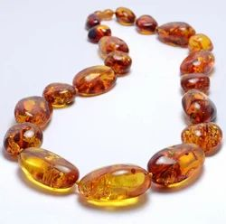
AMBER BEAD

Slide 5
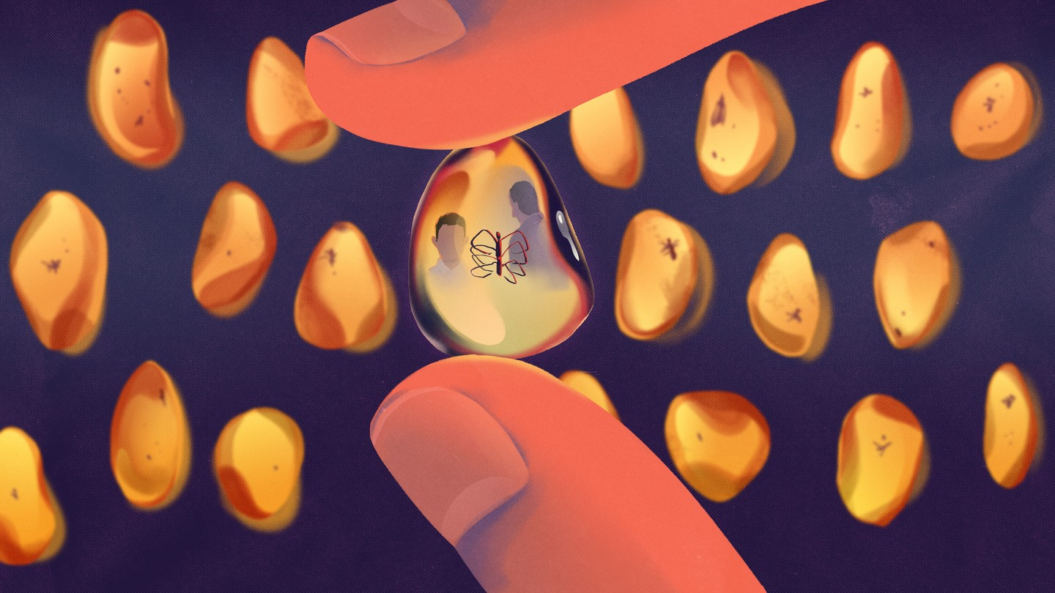
Amber is formed from fossilised tree resin, but may have inclusions of animals, insects, plant debris, minerals, liquids and gases.

Slide 6
Amber is found in many places around the world, from Alaska to Madagascar, but the largest deposits exploited for jewelry and science are in the Dominican Republic, the Baltic region of Europe, and Myanmar, also known as Burma.

Slide 7
https://www.youtube.com/watch?v=dkQ9fQdQJXA
A warm-hued material prized by jewelry makers, amber takes more than 40,000 years to form. See pictures of some of the finest specimens. For many thousands of years, the fossilized tree resin known as amber has entranced jewelry makers and inspired the scientific imagination.

Slide 8
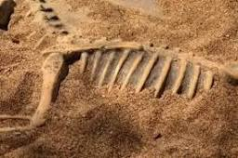
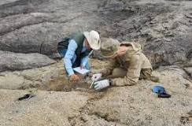
A paleontologist is a scientist who studies the history of life on Earth through the fossil record. Fossils are the evidence of past life on the planet and can include those formed from animal bodies or their imprints (body fossils). Trace fossils are another kind of fossil.

Slide 9

REFERENCES & THANKING SLIDE

